Slide 1
Application Scenarios
Name
Title
Microsoft Corporation

Slide 2
Agenda
Application Scenarios
Web
Technical Computing
Devices
Social Gaming
Social Apps

Slide 3
Web

Slide 4
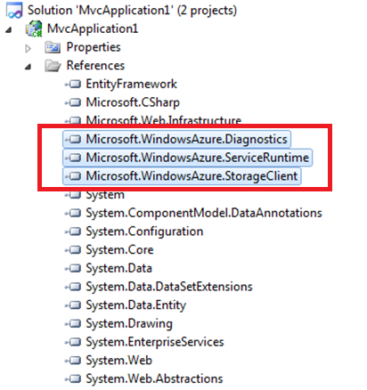
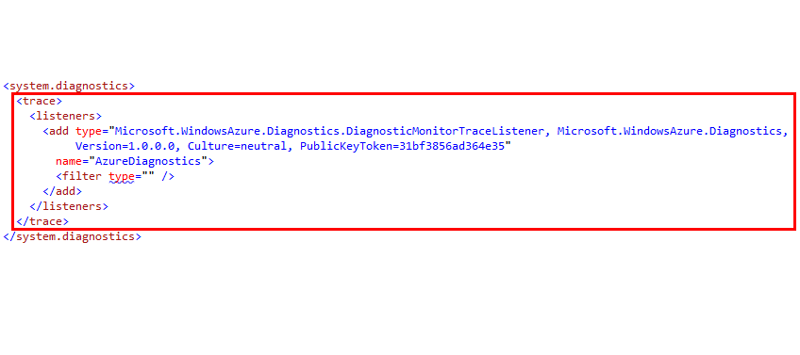
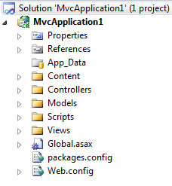
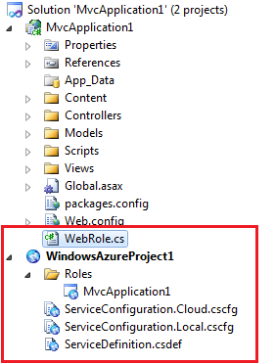
Brown Field

Slide 5
Green Field
ACS
Web Role
CMS partners:
Umbraco
Kentico
SiteCore
Composite
Orchard
Web Role
Web Role
Queue
Web Role
Worker
Cache
Table Storage
Blob Storage
SQL Azure

Slide 6
Key Considerations
Identity
Stateless
MultiTenancy
Deployment

Slide 7
Identity: What are the options?
Create your own
Username + password, token, etc.
ASP.NET Membership Providers
Use a single existing identity system
Live ID, Facebook, etc.
Develop directly against IdP protocol
Outsource identity management
Access Control Service

Slide 8
Stateless
Load balancer round-robins requests in multi-instance roles
Follow web farm best practices
Do not store state on individual instances
Do not assume subsequent requests will hit the same instance
Don’t forget things like dynamically generated images loaded by a page

Slide 9
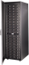
Windows Azure Session State
Windows Azure Load Balancer uses round-robin allocation. Session state must persist to client or storage on every request
session[“foo”] = 1;
LB
session[“foo”] = 2;
What is the value of session[“foo”]?
SQL Azure
Windows Azure Storage

Slide 10
Solving Session State
Persist to Storage via Session State Provider
Windows Azure Caching
SQL Azure
Windows Azure Storage
Persist to Client
Use cookies
Don’t forget ASP.NET MVC TempData relies on Session State provider by default

Slide 11


Multi-Tenancy
SaaS Applications often need to serve multiple tenants out of a single service deployment
<ServiceDefinition name="CloudService" xmlns="http://schemas.microsoft.com/ServiceHosting/2008/10/ServiceDefinition">
<WebRole name="SampleWebApp">
<Sites>
<Site name="tenant1" physicalDirectory="..\MultiTenantWebApp">
<Bindings>
<Binding name="HttpIn" endpointName="HttpIn" hostHeader="tenant1.saasservice.com" />
</Bindings>
</Site>
<Site name="tenant2" physicalDirectory="..\MultiTenantWebApp">
<Bindings>
<Binding name="HttpIn" endpointName="HttpIn" hostHeader="tenant2.saasservice.com" />
</Bindings>
</Site>
<Site name="Litware" physicalDirectory="..\SomeOtherSite">
<Bindings>
<Binding name="HttpIn" endpointName="HttpIn" hostHeader="www.litware.com" />
</Bindings>
</Site>
</Sites>
... </WebRole>
</ServiceDefinition>
tenant1.saasservice.com
tenant2.saasservice.com
LB
Web Roles Shared by all Tenants
resolve tenant by examining host header
SQL Azure
1 DB per Tenant

Slide 12
Startup Tasks
Enables short, unattended setups on role startup
WebPI, Silent MSIs, COM Components, Registry Keys, Configuring Windows Server, etc.
Configured in the .csdef

Slide 13


Startup Tasks
Task Type
Simple – role waits for the task to exit
Background – role continues to run while tasks run
Foreground – same as background, but role cant be stopped until tasks exit
<WebRole name=“FabrikamShipping.App.Web">
<Startup>
<Task commandline="relative\path\ToSetupExecutable"
executionContext="limited|elevated"
taskType=“simple|foreground|background"/>
</Startup>
</WebRole>

Slide 14
Deployment
Getting it up there
DNS
Package, Publish, Web Deploy*
In place upgrade
VIP Swap
1 instance use Web deploy
Web deploy >1 instance can use Windows Azure Accelerator for Web Roles
All services get a *.cloudapp.net address
Standard approach is to CNAME to *.cloudapp.net
High perf Approach
Resolve IP for yourapp.cloudapp.net
Create an A Record

Slide 15
Technical Computing

Slide 16
Example Workloads
Digital media rendering and encoding
Financial and insurance risk calculation
Engineering modeling and simulation
Computational life sciences
Earth sciences
Data analytics

Slide 17
What’s the Problem?
Some apps run too slowly on a single computer
Splitting them up into chunks, then running those chunks in parallel on multiple computers can speed them up
Doing this effectively requires creating a compute cluster, with:
Tools to create and manage the cluster
A scheduler to keep the cluster busy running apps

Slide 18


Windows Azure Scheduler HPC SP3 TK
Job submission API and portal
Job queue and priorities
Resource sharing policies
Parametric Sweeps
Cluster SOA
MPI
LINQ to HPC
Job Scheduler
Distributed Runtimes

Slide 19
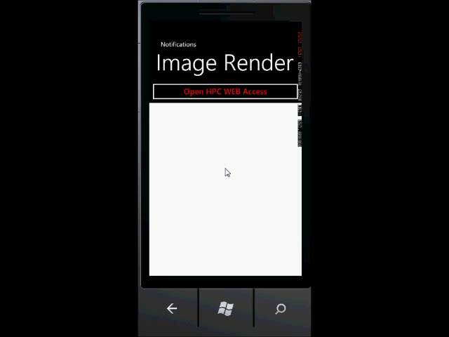
Using Windows Azure Scheduler Portal
Compute Worker
Worker Role: Job Management
HPC Node Manager
Work
…
WA Web Portal
Windows Azure Scheduler
Compute Worker
REST API
Compute Worker
Compute Worker
Standard Windows Azure Scheduler Portal
and Scheduler REST API
Compute Worker
Azure Storage
(Blob, Table, DB)
Notes:
Click Play on the WP7 device

Slide 20
Devices

Slide 21
Many Different Devices
Windows Phone
Android
iOS
Windows 8

Slide 22
Common Device Scenarios Use
1
3
Storage
Communications
2
4
Identity
Platform Services

Slide 23
Storage - Recap
Windows Azure Tables
Windows Azure Blobs
Windows Azure Queues
SQL Azure

Slide 24
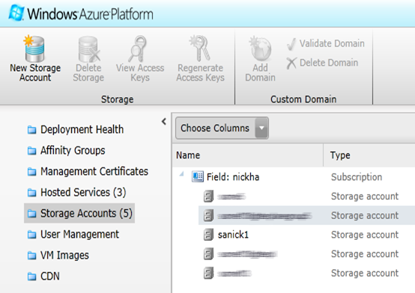
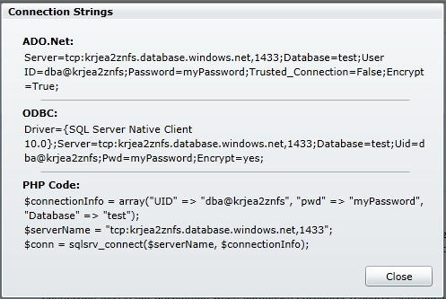
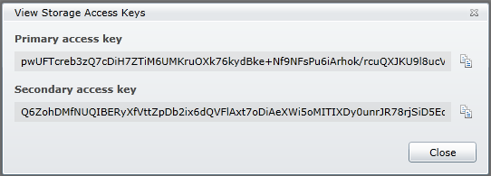
Storage: Secrets
Windows Azure
Storage name
Storage key
SQL Azure
Username
Password
Once you share your secret, it’s no longer secret

Slide 25
Blob Storage: How do we keep secrets secret?
Proxy the requests
1. Client sends data to web role
2. Web role sends data to storage
(2)
Web Role
(1)
Notes:
This pattern also applies to table storage.

Slide 26
Blob Storage: Using Shared Access Signatures
1. Client makes request of Web Role for SAS
2. Web Role sends client SAS
3. Client makes request
4. Client gets response
(3)
(4)
Web Role
(2)
(1)
Notes:
Contrast with pattern of prior slide for blobs. This reduces load on web role thereby resulting in less need for early scale out of web tier.

Slide 27
Storage: SQL Azure
1. Client sends request to proxy
2. Proxy makes SQL call against SQL Azure
3. SQL Azure returns a response
4. Proxy returns response to device
(2)
(3)
Web Role
(4)
(1)

Slide 28
Storage: Offloading work through queues
1. Client writes a message to a queue
2. Worker role is polling the queue
3. Worker role finds the message
Worker Role
(2)
(3)
(1)

Slide 29
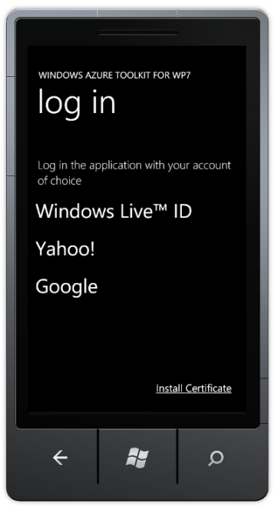
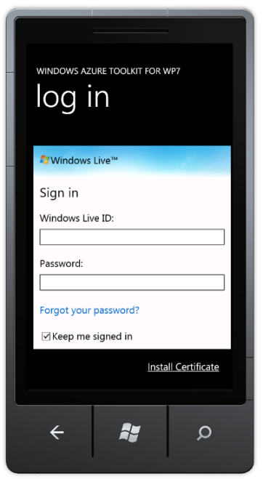
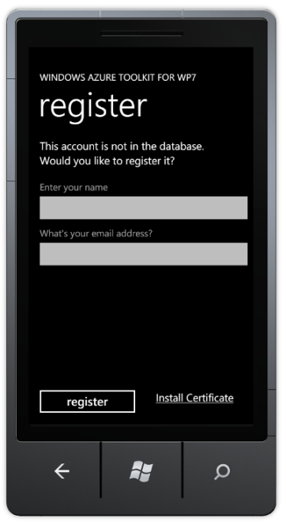
Identity: Authenticating Users with ACS
Web Role
Access Control Service

Slide 30
Communications
Two forms of communication with devices
Device-initiated
Cloud-initiated

Slide 31
Communications: Device-initiated
<?xml version="1.0" encoding="utf-8" standalone="yes" ?> - <feed xml:base="http://localhost:33779/WcfDataService1.svc/" xmlns:d="http://schemas.microsoft.com/ado/2007/08/dataservices" xmlns:m="http://schemas.microsoft.com/ado/2007/08/dataservices/metadata" xmlns="http://www.w3.org/2005/Atom"> <title type="text">Drivers</title> <id>http://localhost:33779/WcfDataService1.svc/Drivers</id> <updated>2010-05-24T22:12:38Z</updated> <link rel="self" title="Drivers" href="Drivers" /> - <entry> <id>http://localhost:33779/WcfDataService1.svc/Drivers(1)</id> <title type="text" /> <updated>2010-05-24T22:12:38Z</updated> - <author> <name /> </author> <link rel="edit" title="Driver" href="Drivers(1)" /> <link rel="http://schemas.microsoft.com/ado/2007/08/dataservices/related/DistributionCenter" type="application/atom+xml;type=entry" title="DistributionCenter" href="Drivers(1)/DistributionCenter" /> <link rel="http://schemas.microsoft.com/ado/2007/08/dataservices/related/Todays" type="application/atom+xml;type=feed" title="Todays" href="Drivers(1)/Todays" /> <category term="ContosoBottlingModel.Driver" scheme="http://schemas.microsoft.com/ado/2007/08/dataservices/scheme" /> - <content type="application/xml"> - <m:properties> <d:DriverId m:type="Edm.Int32">1</d:DriverId> <d:DistributionCenterId m:type="Edm.Int32">1</d:DistributionCenterId> <d:FirstName>Rob</d:FirstName> <d:LastName>Tiffany</d:LastName> </m:properties> </content> </entry> - <entry> <id>http://localhost:33779/WcfDataService1.svc/Drivers(2)</id> <title type="text" /> <updated>2010-05-24T22:12:38Z</updated> - <author> <name /> </author> <link rel="edit" title="Driver" href="Drivers(2)" /> <link rel="http://schemas.microsoft.com/ado/2007/08/dataservices/related/DistributionCenter" type="application/atom+xml;type=entry" title="DistributionCenter" href="Drivers(2)/DistributionCenter" /> <link rel="http://schemas.microsoft.com/ado/2007/08/dataservices/related/Todays" type="application/atom+xml;type=feed" title="Todays" href="Drivers(2)/Todays" /> <category term="ContosoBottlingModel.Driver" scheme="http://schemas.microsoft.com/ado/2007/08/dataservices/scheme" /> - <content type="application/xml"> - <m:properties> <d:DriverId m:type="Edm.Int32">2</d:DriverId> <d:DistributionCenterId m:type="Edm.Int32">1</d:DistributionCenterId> <d:FirstName>Loke Uei</d:FirstName> <d:LastName>Tan</d:LastName> </m:properties> </content> </entry> - <entry> <id>http://localhost:33779/WcfDataService1.svc/Drivers(3)</id> <title type="text" /> <updated>2010-05-24T22:12:38Z</updated> - <author> <name /> </author> <link rel="edit" title="Driver" href="Drivers(3)" /> <link rel="http://schemas.microsoft.com/ado/2007/08/dataservices/related/DistributionCenter" type="application/atom+xml;type=entry" title="DistributionCenter" href="Drivers(3)/DistributionCenter" /> <link rel="http://schemas.microsoft.com/ado/2007/08/dataservices/related/Todays" type="application/atom+xml;type=feed" title="Todays" href="Drivers(3)/Todays" /> <category term="ContosoBottlingModel.Driver" scheme="http://schemas.microsoft.com/ado/2007/08/dataservices/scheme" /> - <content type="application/xml"> - <m:properties> <d:DriverId m:type="Edm.Int32">3</d:DriverId> <d:DistributionCenterId m:type="Edm.Int32">1</d:DistributionCenterId> <d:FirstName>Dan</d:FirstName> <d:LastName>Bouie</d:LastName> </m:properties> </content> </entry> - <entry> <id>http://localhost:33779/WcfDataService1.svc/Drivers(4)</id> <title type="text" /> <updated>2010-05-24T22:12:38Z</updated> - <author> <name /> </author> <link rel="edit" title="Driver" href="Drivers(4)" /> <link rel="http://schemas.microsoft.com/ado/2007/08/dataservices/related/DistributionCenter" type="application/atom+xml;type=entry" title="DistributionCenter" href="Drivers(4)/DistributionCenter" /> <link rel="http://schemas.microsoft.com/ado/2007/08/dataservices/related/Todays" type="application/atom+xml;type=feed" title="Todays" href="Drivers(4)/Todays" /> <category term="ContosoBottlingModel.Driver" scheme="http://schemas.microsoft.com/ado/2007/08/dataservices/scheme" /> - <content type="application/xml"> - <m:properties> <d:DriverId m:type="Edm.Int32">4</d:DriverId> <d:DistributionCenterId m:type="Edm.Int32">1</d:DistributionCenterId> <d:FirstName>John</d:FirstName> <d:LastName>Dietz</d:LastName> </m:properties> </content> </entry> - <entry> <id>http://localhost:33779/WcfDataService1.svc/Drivers(5)</id> <title type="text" /> <updated>2010-05-24T22:12:38Z</updated> - <author> <name /> </author> <link rel="edit" title="Driver" href="Drivers(5)" /> <link rel="http://schemas.microsoft.com/ado/2007/08/dataservices/related/DistributionCenter" type="application/atom+xml;type=entry" title="DistributionCenter" href="Drivers(5)/DistributionCenter" /> <link rel="http://schemas.microsoft.com/ado/2007/08/dataservices/related/Todays" type="application/atom+xml;type=feed" title="Todays" href="Drivers(5)/Todays" /> <category term="ContosoBottlingModel.Driver" scheme="http://schemas.microsoft.com/ado/2007/08/dataservices/scheme" /> - <content type="application/xml"> - <m:properties> <d:DriverId m:type="Edm.Int32">5</d:DriverId> <d:DistributionCenterId m:type="Edm.Int32">2</d:DistributionCenterId> <d:FirstName>Derek</d:FirstName> <d:LastName>Snyder</d:LastName> </m:properties> </content> </entry> - <entry> <id>http://localhost:33779/WcfDataService1.svc/Drivers(6)</id> <title type="text" /> <updated>2010-05-24T22:12:38Z</updated> - <author> <name /> </author> <link rel="edit" title="Driver" href="Drivers(6)" /> <link rel="http://schemas.microsoft.com/ado/2007/08/dataservices/related/DistributionCenter" type="application/atom+xml;type=entry" title="DistributionCenter" href="Drivers(6)/DistributionCenter" /> <link rel="http://schemas.microsoft.com/ado/2007/08/dataservices/related/Todays" type="application/atom+xml;type=feed" title="Todays" href="Drivers(6)/Todays" /> <category term="ContosoBottlingModel.Driver" scheme="http://schemas.microsoft.com/ado/2007/08/dataservices/scheme" /> - <content type="application/xml"> - <m:properties> <d:DriverId m:type="Edm.Int32">6</d:DriverId> <d:DistributionCenterId m:type="Edm.Int32">2</d:DistributionCenterId> <d:FirstName>Steve</d:FirstName> <d:LastName>Hegenderfer</d:LastName> </m:properties> </content> </entry> - <entry> <id>http://localhost:33779/WcfDataService1.svc/Drivers(7)</id> <title type="text" /> <updated>2010-05-24T22:12:38Z</updated> - <author> <name /> </author> <link rel="edit" title="Driver" href="Drivers(7)" /> <link rel="http://schemas.microsoft.com/ado/2007/08/dataservices/related/DistributionCenter" type="application/atom+xml;type=entry" title="DistributionCenter" href="Drivers(7)/DistributionCenter" /> <link rel="http://schemas.microsoft.com/ado/2007/08/dataservices/related/Todays" type="application/atom+xml;type=feed" title="Todays" href="Drivers(7)/Todays" /> <category term="ContosoBottlingModel.Driver" scheme="http://schemas.microsoft.com/ado/2007/08/dataservices/scheme" /> - <content type="application/xml"> - <m:properties> <d:DriverId m:type="Edm.Int32">7</d:DriverId> <d:DistributionCenterId m:type="Edm.Int32">2</d:DistributionCenterId> <d:FirstName>Chip</d:FirstName> <d:LastName>Vollers</d:LastName> </m:properties> </content> </entry> - <entry> <id>http://localhost:33779/WcfDataService1.svc/Drivers(8)</id> <title type="text" /> <updated>2010-05-24T22:12:38Z</updated> - <author> <name /> </author> <link rel="edit" title="Driver" href="Drivers(8)" /> <link rel="http://schemas.microsoft.com/ado/2007/08/dataservices/related/DistributionCenter" type="application/atom+xml;type=entry" title="DistributionCenter" href="Drivers(8)/DistributionCenter" /> <link rel="http://schemas.microsoft.com/ado/2007/08/dataservices/related/Todays" type="application/atom+xml;type=feed" title="Todays" href="Drivers(8)/Todays" /> <category term="ContosoBottlingModel.Driver" scheme="http://schemas.microsoft.com/ado/2007/08/dataservices/scheme" /> - <content type="application/xml"> - <m:properties> <d:DriverId m:type="Edm.Int32">8</d:DriverId> <d:DistributionCenterId m:type="Edm.Int32">2</d:DistributionCenterId> <d:FirstName>James</d:FirstName> <d:LastName>Pratt</d:LastName> </m:properties> </content> </entry> </feed>
The same list of 8 Customers using SOAP and a DataSet dropped us down to 3 kb but still too big for my taste.
<?xml version="1.0" encoding="utf-8"?> <DataSet xmlns="http://tempuri.org/"> <xs:schema id="NewDataSet" xmlns="" xmlns:xs="http://www.w3.org/2001/XMLSchema" xmlns:msdata="urn:schemas-microsoft-com:xml-msdata"> <xs:element name="NewDataSet" msdata:IsDataSet="true" msdata:UseCurrentLocale="true"> <xs:complexType> <xs:choice minOccurs="0" maxOccurs="unbounded"> <xs:element name="Driver"> <xs:complexType> <xs:sequence> <xs:element name="DriverId" type="xs:int" minOccurs="0" /> <xs:element name="DistributionCenterId" type="xs:int" minOccurs="0" /> <xs:element name="FirstName" type="xs:string" minOccurs="0" /> <xs:element name="LastName" type="xs:string" minOccurs="0" /> </xs:sequence> </xs:complexType> </xs:element> </xs:choice> </xs:complexType> </xs:element> </xs:schema> <diffgr:diffgram xmlns:msdata="urn:schemas-microsoft-com:xml-msdata" xmlns:diffgr="urn:schemas-microsoft-com:xml-diffgram-v1"> <NewDataSet xmlns=""> <Driver diffgr:id="Driver1" msdata:rowOrder="0"> <DriverId>1</DriverId> <DistributionCenterId>1</DistributionCenterId> <FirstName>Rob</FirstName> <LastName>Tiffany</LastName> </Driver> <Driver diffgr:id="Driver2" msdata:rowOrder="1"> <DriverId>2</DriverId> <DistributionCenterId>1</DistributionCenterId> <FirstName>Loke Uei</FirstName> <LastName>Tan</LastName> </Driver> <Driver diffgr:id="Driver3" msdata:rowOrder="2"> <DriverId>3</DriverId> <DistributionCenterId>1</DistributionCenterId> <FirstName>Dan</FirstName> <LastName>Bouie</LastName> </Driver> <Driver diffgr:id="Driver4" msdata:rowOrder="3"> <DriverId>4</DriverId> <DistributionCenterId>1</DistributionCenterId> <FirstName>John</FirstName> <LastName>Dietz</LastName> </Driver> <Driver diffgr:id="Driver5" msdata:rowOrder="4"> <DriverId>5</DriverId> <DistributionCenterId>2</DistributionCenterId> <FirstName>Derek</FirstName> <LastName>Snyder</LastName> </Driver> <Driver diffgr:id="Driver6" msdata:rowOrder="5"> <DriverId>6</DriverId> <DistributionCenterId>2</DistributionCenterId> <FirstName>Steve</FirstName> <LastName>Hegenderfer</LastName> </Driver> <Driver diffgr:id="Driver7" msdata:rowOrder="6"> <DriverId>7</DriverId> <DistributionCenterId>2</DistributionCenterId> <FirstName>Chip</FirstName> <LastName>Vollers</LastName> </Driver> <Driver diffgr:id="Driver8" msdata:rowOrder="7"> <DriverId>8</DriverId> <DistributionCenterId>2</DistributionCenterId> <FirstName>James</FirstName> <LastName>Pratt</LastName> </Driver> </NewDataSet> </diffgr:diffgram> </DataSet>
<ArrayOfDriver xmlns=http://schemas.datacontract.org/2004/07/ContosoWcfService.Models
xmlns:i="http://www.w3.org/2001/XMLSchema-instance"> <Driver> <DistributionCenterId>1</DistributionCenterId> <DriverId>1</DriverId> <FirstName>Rob</FirstName> <LastName>Tiffany</LastName> </Driver> <Driver> <DistributionCenterId>1</DistributionCenterId> <DriverId>2</DriverId> <FirstName>Loke Uei</FirstName> <LastName>Tan</LastName> </Driver> <Driver> <DistributionCenterId>1</DistributionCenterId> <DriverId>3</DriverId> <FirstName>Dan</FirstName> <LastName>Bouie</LastName> </Driver> <Driver> <DistributionCenterId>1</DistributionCenterId> <DriverId>4</DriverId> <FirstName>John</FirstName> <LastName>Dietz</LastName> </Driver> <Driver> <DistributionCenterId>2</DistributionCenterId> <DriverId>5</DriverId> <FirstName>Derek</FirstName> <LastName>Snyder</LastName> </Driver> <Driver> <DistributionCenterId>2</DistributionCenterId> <DriverId>6</DriverId> <FirstName>Steve</FirstName> <LastName>Hegenderfer</LastName> </Driver> <Driver> <DistributionCenterId>2</DistributionCenterId> <DriverId>7</DriverId> <FirstName>Chip</FirstName> <LastName>Vollers</LastName> </Driver> <Driver> <DistributionCenterId>2</DistributionCenterId> <DriverId>8</DriverId> <FirstName>James</FirstName> <LastName>Pratt</LastName> </Driver> </ArrayOfDriver>
Device-initiated options
HTTP-based, request/response
Framework choices (WCF, OData, WebRequest, etc.)
Wire format choices (SOAP, JSON, POX, etc.)
[{"DistributionCenterId":1,"DriverId":1,"FirstName":"Rob","LastName":"Tiffany"},
{"DistributionCenterId":1,"DriverId":2,"FirstName":"Loke Uei","LastName":"Tan"},
{"DistributionCenterId":1,"DriverId":3,"FirstName":"Dan","LastName":"Bouie"},
{"DistributionCenterId":1,"DriverId":4,"FirstName":"John","LastName":"Dietz"},
{"DistributionCenterId":2,"DriverId":5,"FirstName":"Derek","LastName":"Snyder"},
{"DistributionCenterId":2,"DriverId":6,"FirstName":"Steve","LastName":“Harris"},
{"DistributionCenterId":2,"DriverId":7,"FirstName":"Chip","LastName":"Vollers"},
{"DistributionCenterId":2,"DriverId":8,"FirstName":"James","LastName":"Pratt"}]
OData 8.5kb
REST+XML 1.2kb
JSON
639 bytes
Notes:
Case study of same 8 customers with different serialization strategies.
Compare 8.5kb verse 639b. Simple change in serialization results in:
13 times more efficient
13 times more users/requests|response for a single instance
1/13 of the instances required – cost impact

Slide 32
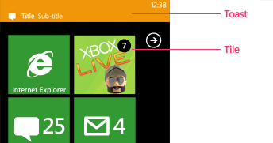

Communications: Cloud-initiated
Push Notifications
Single connecting between the device and the notification service
Bandwidth- and battery-friendly
No guarantee of delivery

Slide 33
Notifications: Different services
Windows 8: Windows Push Notification Service (WNS)
Windows Phone: Microsoft Push Notification Service (MPNS)
iOS: Apple Push Notification Service (APNS)
Android: Cloud To Device Messaging (C2DM)
…

Slide 34
Communications: Subscribing to Push
Device requests a channel
*NS returns channel
Device sends URL to cloud
Channel URL is stored in cloud
Cloud sends notification
*NS pushes to device
*NS
Web Role

Slide 35
Communications: Cloud-initiated to device?
Common pattern
Use cloud-initiated push to tell the device to call to a service
Cloud sends notification
Notification services pushes to device
Device receives message and calls to a service
Web Role sends a response
*NS
Web Role

Slide 36
Platform Services
Content Delivery Network (CDN)
Traffic Manager
SQL Azure Data Sync
Caching

Slide 37
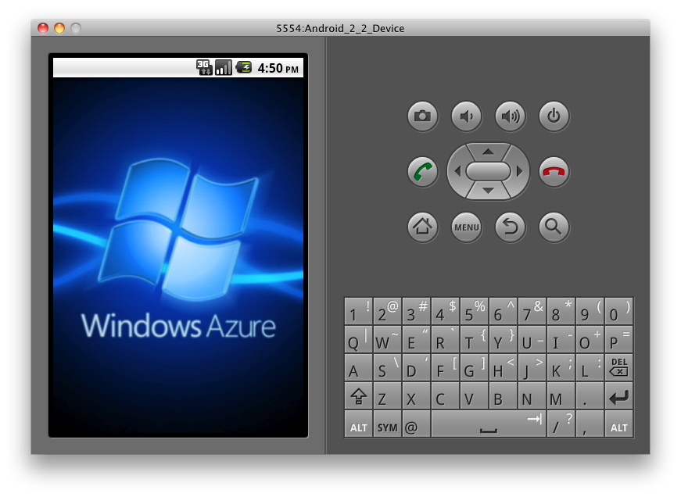
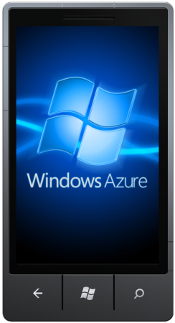
Windows Azure Toolkits for Devices
Easier for device developers to use Windows Azure
Windows Phone: http://bit.ly/watwp7
iOS: http://bit.ly/watios
Android: http://bit.ly/watandroid
Toolkits include:
Native libraries (e.g. .NET, Objective-C)
Samples
Project templates
Documentation
In Action
BabelCam for Windows Phone

Slide 38
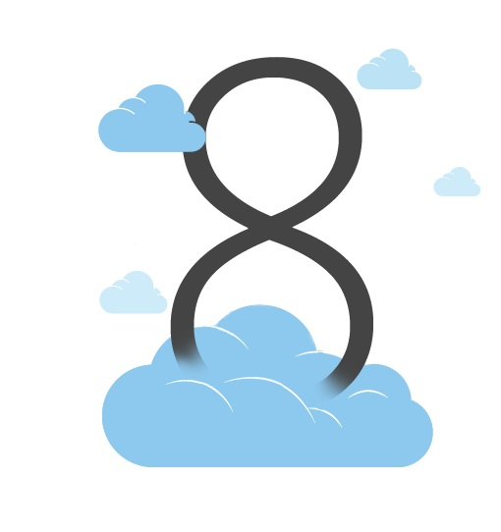
Windows Azure Toolkit for Windows 8
Deliver a Push Notification Cloud Service with ease.
VS 2010 Project Template for Windows Azure
Dev 11 Project for Client
Samples:
ACS Metro Style App
Margie’s Travel
Push Notification Worker
Documentation
Download at: http://watwindows8.codeplex.com/

Slide 39
Gaming

Slide 40
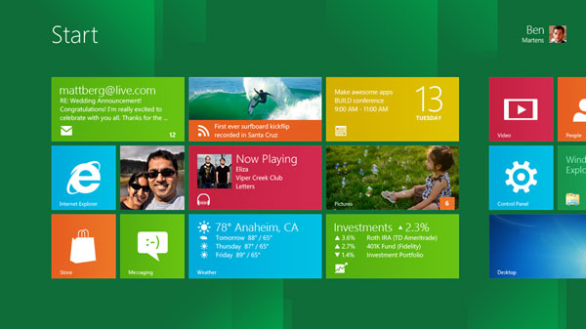
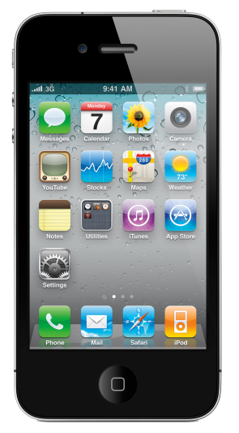
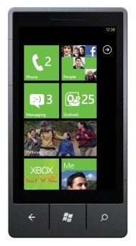
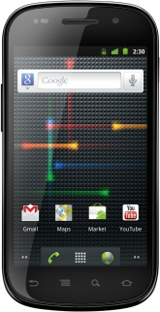


Features of Connected Games

Slide 41
Features of Connected Games
Authentication
User Settings
State Storage
Real-Time Communication
Game Services: i.e. Leaderboard & Achievements

Slide 42
Windows Azure Toolkit for Social Games
Weapons
Gifts
Achievements
User Profiles
Notifications
Real-Time Communication
User Sessions
Leaderboards
Game Play Commands
Samples
http://watgames.codeplex.com

Slide 43
Windows Azure Toolkit for Social Games
Command – Query Separation
Reliance on Windows Azure Storage
Queues
Blobs
Rest Services

Slide 44
Social Gaming Command Query Pattern
Write
Read
Sessions Container
Game Queues Container
Games Container
Skirmish
GameQueue
Drew (user id)
blob
Game Queue
12F…C638
blob
Game
718…AB13
blob
Mike (user id)
blob
Game Queue
9B6…A6E1
blob
Game
1A2…97EA
blob
Game Play API
Web Role
Game Play
Worker Role
…
…
…
John (user id)
blob
Game Queue
A62…DDE1
blob
Game
E37…72AE
blob
John

Slide 45
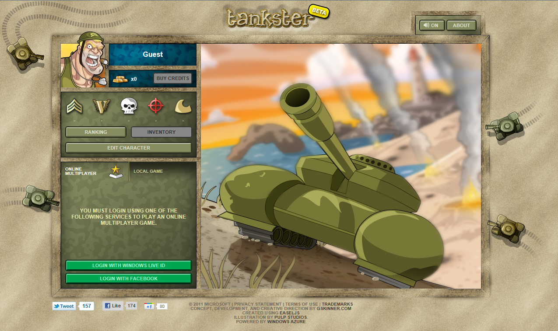
Notes:
http://www.tankster.net
Alternative -
From browser (first player who starts the game should append the query string id=room)
http://tictactoe.cloudapp.net/3tb.html?id=room
(second player)
http://tictactoe.cloudapp.net/3tb.html

Slide 46
Social Apps

Slide 47
Facebook
Why?
Reach an audience of more than 800 million active users
Connect to Facebook’s rich application platform
Broad Reach across devices
Notes:
Scale when you go viral

Slide 48
Facebook
What?
Facebook Core Apps
Communication
Games
Media - Music, Movies, TV, News, and Books
Lifestyle - Fitness, Eating, Fashion, and Recreation
Notes:
Scale when you go viral

Slide 49
Facebook + Windows Azure Development
Scale when needed
Pay for only what you use
Focus on code
Iterate rapidly
Client Side
Facebook JavaScript SDK
Server Side
Facebook C# SDK
Facebook PHP SDK
Benefits
Tools

Slide 50
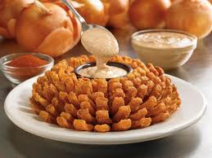

Thuzi: Outback Steakhouse App
Scenario
Outback Steakhouse wanted to encourage repeat guests by creating a social networking presence.
Marketing Campaign with a short cycle
Free Bloomin’ Onion coupon to the First 500,000 guests on the Outback Facebook Fan Page
Company Goal was to reach 500,000 fans in 30 days.
Outcome
No outlay for on premise hardware
Needed to scale quickly for spikes and cost-effectively
support an unknown number of respondents
Solution used Windows Azure with an asynchronous architecture.
Web + Worker roles, Cache, SQL Azure, Table Storage
8 weeks development using familiar development tools
Viral campaign achieved its 500,000 fans in just 18 days.
www.outback.com

Slide 51
Summary
Application Scenarios
Web
Technical Computing
Devices
Social Gaming
Social Apps

Slide 52

Thank you

